Slide 1
Angular Features
ES6 and TypeScript Support
Speed & Performance
Modular
Support mobile, tablet etc.

Slide 2
Building Blocks Of Angular
Module
Component
Router
Template
Data Binding
Service
Directives

Slide 3
Building Blocks Of Angular
Module
Every Angular has at least one root module
Encapsulation of different similar Functionalities
Components
Similar
Functionalities
Directives
Single Module
Services

Slide 4
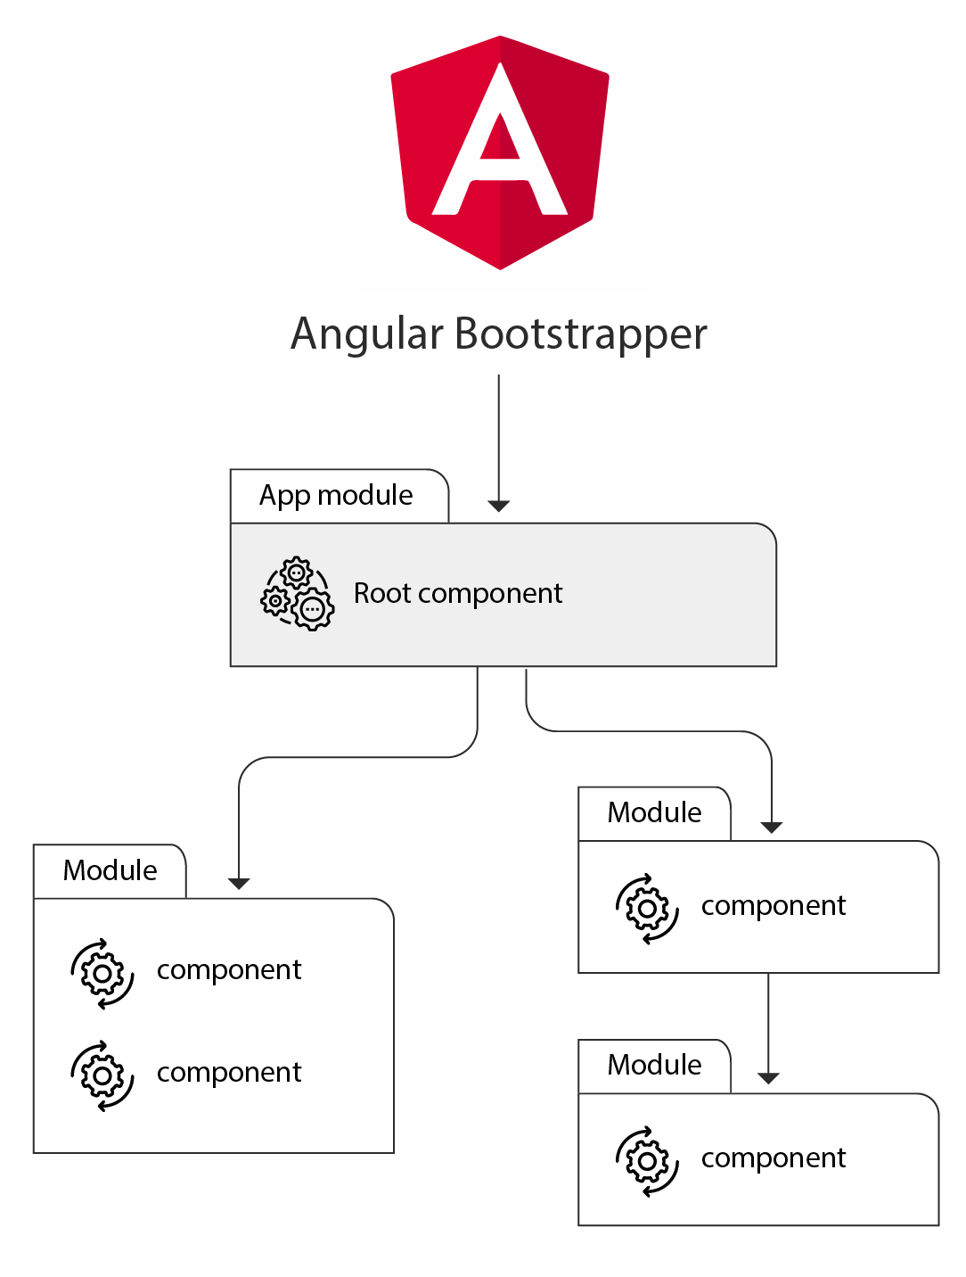
Building Blocks Of Angular
Template / Component
Components – combination of encapsulated html + javascript + styles
Functionalities divided into different component under different modules
Increases reusability
Reduce complexity
Maintainable large code

Slide 5
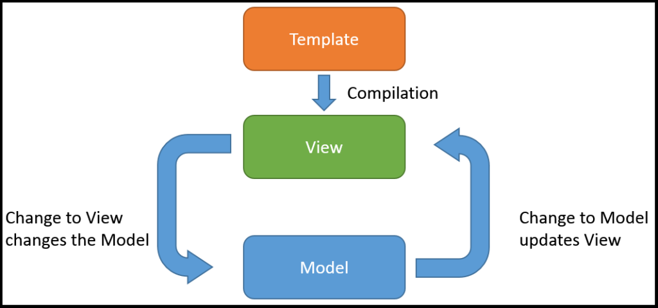
Building Blocks Of Angular
Data Binding
Data updates in HTML in no time,
as soon as API provide it.
Observables - Even one or more complex Asynchronous call can be handled seamlessly.

Slide 6



Building Blocks Of Angular
Services
Creates a new instance of class along with its required dependencies
Used to provide services to a component
Service 1
{ }
Service 2
{ }
Service 3
{ }
Dependency Injection
Service 2
{ }
Component

Slide 7
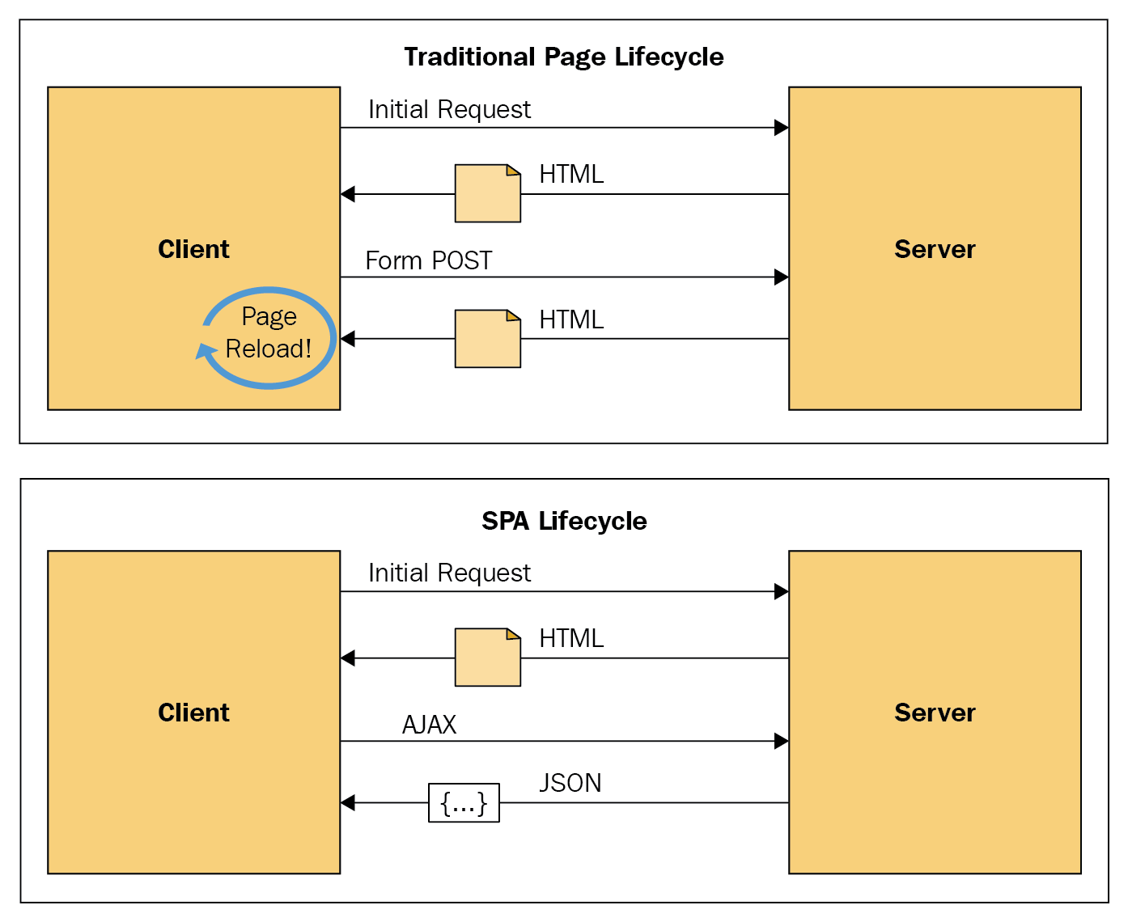
Building Blocks Of Angular
Router & Single Page Application
Router makes Angular to load modules/components on demand.
Result –
Limited package size
Faster initial load of an App
Get more API calls without refreshing a page like Facebook does

Slide 8

Feature of Angular CLI
The CLI makes it easy for developers.
Conditional Polyfill Serving (consistent on every browser).
Hidden Source Maps (Easy Debugging).
Commands to execute automation for-
(not only creating but configuration too)
components
Complex route
Pre processor CSS
Creating Module
Service
Test runs
Minification
Map file for smooth debugging for developer
And Yes, make deployment Build as well with one single command.

